Slide 1
OMG MONSTERS!
James Liu
Anupam Goli
Dhruv Karunakaran

Slide 2
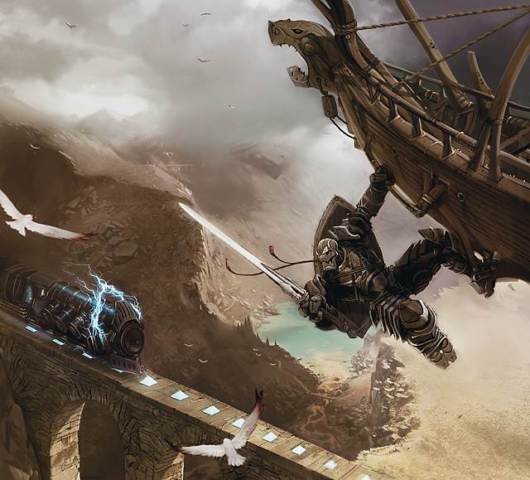
What is it?
Hack-n-Slash , Beat-em-up, Arena type game
Programmed in C#/XNA
Theme is magic punk.

Slide 3
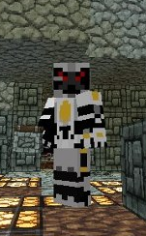
About Us
James Liu
Coder (rubix cube project)
Dhruv Karunakaran
Pixel art/photoshop
Musician
Anupam Goli
Mainly programming
Katherine Andux
Music
First game project

Slide 4
What do we have so far???
Let’s see here. …

Slide 5
What we need…
Backgrounds for maps
Additional shader work
Sprite design
Music

Slide 6
Who do we need?
Sound peoples, music/sound effects/etc. (1)
Artists, pixel artists, background artists, promo artists (1+)
Enemy/AI Programmers (1-2)
Generic C#/XNA Programmers (1)
Those who have experience with shaders (1)

